Slide 1
Exception Handling in C++
1
Chapter 11

Slide 2
Objectives
What is a C++ Exception?
Types of C++ Exception
Syntax for Exception Handling in C++
Why do we need Exception Handling in C++?
Properties of Exception Handling in C++
2

Slide 3
Exception Handling in C++
An exception is an unexpected event that occurs during program execution. For example,
divide_by_zero = 7 / 0;
The above code causes an exception as it is not possible to divide a number by 0.
The process of handling these types of errors in C++ is known as exception handling.
So basically using exception handling in C++, we can handle the exceptions so that our program keeps running.
3

Slide 4
What is a C++ Exception?
An exception is an unexpected problem that arises during the execution of a program, our program terminates suddenly with some errors/issues. Exception occurs during the running of the program (runtime).
Types of C++ Exception
There are two types of exceptions in C++
Synchronous: Exceptions that happen when something goes wrong because of a mistake in the input data or when the program is not equipped to handle the current type of data it’s working with, such as dividing a number by zero.
Asynchronous: Exceptions that are beyond the program’s control, such as disc failure, keyboard interrupts, etc.
4

Slide 5
Syntax for Exception Handling in C++
The basic syntax for exception handling in C++ is given below:
try {
// Code that might throw an exception
throw SomeExceptionType("Error message");
}
catch( ExceptionName e1 ) {
// catch block catches the exception that is thrown from try block
}
Here, we have placed the code that might generate an exception inside the try block. Every try block is followed by the catch block.
When an exception occurs, the throw statement throws an exception, which is caught by the catch block.
The catch block cannot be used without the try block.
5

Slide 6
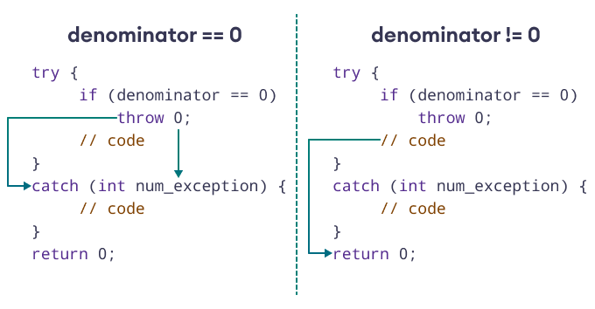
Example for Exception Handling in C++
// program to divide two numbers, throws an exception when the divisor is 0
int main() {
double numerator, denominator, divide;
cout << "Enter numerator: "; cin >> numerator;
cout << "Enter denominator: "; cin >> denominator;
try {
// throw an exception if denominator is 0
if (denominator == 0)
throw 0;
// not executed if denominator is 0
divide = numerator / denominator;
cout << numerator << " / " << denominator << " = " << divide << endl;
}
catch (int num_exception) {
cout << "Error: Cannot divide by " << num_exception << endl;
}
return 0;
}
6

Slide 7
Why do we need Exception Handling in C++?
The following are the main advantages of exception handling over traditional error handling:
Separation of Error Handling Code from Normal Code: There are always if-else conditions to handle errors in traditional error handling codes. These conditions and the code to handle errors get mixed up with the normal flow. This makes the code less readable and maintainable. With try/catch blocks, the code for error handling becomes separate from the normal flow.
Functions/Methods can handle only the exceptions they choose: A function can throw many exceptions, but may choose to handle some of them. The other exceptions, which are thrown but not caught, can be handled by the caller. In C++, a function can specify the exceptions that it throws using the throw keyword. The caller of this function must handle the exception in some way (either by specifying it again or catching it).
Grouping of Error Types: In C++, both basic types and objects can be thrown as exceptions. We can create a hierarchy of exception objects, group exceptions in namespaces or classes, and categorize them according to their types.
7

Slide 8
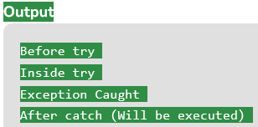
Example of Exception Handling in C++?
// C++ program to demonstrate the use of try, catch and throw in exception handling
int main()
{ int x = -1;
// Some code
cout << "Before try \n";
// try block
try {
cout << "Inside try \n";
if (x < 0) { throw x; // throwing an exception
cout << "After throw (Never executed) \n";
}
}
// catch block
catch (int x) { cout << "Exception Caught \n"; }
cout << "After catch (Will be executed) \n";
return 0;
}
8

Slide 9

Properties of Exception Handling in C++
Property 1
There is a special catch block called the ‘catch-all’ block, written as
catch(…), that can be used to catch all types of exceptions.
Example
In the following program, an int is thrown as an exception, but there is no catch block for int, so the catch(…) block will be executed.
// C++ program to demonstrate the use of catch all in exception handling.
int main()
{ // try block
try { // throw
throw 10;}
catch (char* excp) {// catch block
cout << "Caught " << excp; }
catch (...) {// catch all
cout << "Default Exception\n"; }
return 0;
}
9

Slide 10

Properties of Exception Handling in C++
Property 2:
Implicit type conversion doesn’t happen for primitive types.
Example
In the following program, ‘a’ is not implicitly converted to int.
//// C++ program to demonstrate property 2: Implicit type
/// conversion doesn't happen for primitive types. in exception handling.
#include <iostream>
using namespace std;
int main()
{
try { throw 'a';
}
catch (int x) { cout << "Caught " << x;
}
catch (...) {
cout << "Default Exception\n";
}
return 0;
}
10

Slide 11

Properties of Exception Handling in C++
Property 3
If an exception is thrown and not caught anywhere,
the program terminates abnormally.
Example
In the following program, a char is thrown, but there is no catch block to catch the char. // C++ program to demonstrate property 3: If an exception is
// thrown and not caught anywhere, the program terminates abnormally in exception handling.
#include <iostream>
using namespace std;
int main()
{
try { throw 'a';
}
catch (int x) { cout << "Caught ";
}
return 0;
}
11

Slide 12
Properties of Exception Handling in C++
Property 4:In C++, try/catch blocks can be nested. Also, an exception can be re-thrown using “throw; “.
Example
The following program shows try/catch blocks nesting.
// C++ program to demonstrate try/catch blocks can be nested in C++
#include <bits/stdc++.h>
using namespace std;
int main() {
try { cout << "Outer try block started." << endl;
try { cout << "Inner try block started." << endl;
throw 20;
cout << "This line will not be executed." << endl; }
catch (int inner_exception) {
cout << "Inner catch block: Caught exception with value: " << inner_exception <<endl; }
cout << "Outer try block finished." << endl;
throw 10; }
catch (...) { cout << "Outer catch block: Caught an exception." << endl; } return 0;
}
Output:
Outer try block started.
Inner try block started.
Inner catch block: Caught exception with value: 20
Outer try block finished.
Outer catch block: Caught an exception.
12

Slide 13
Lecture Contents
Teach Yourself C++
Chapter 11 (with exercises)
Study the examples from the book carefully
13

